Slide 1
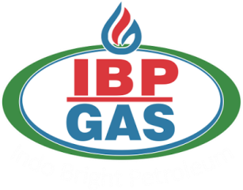
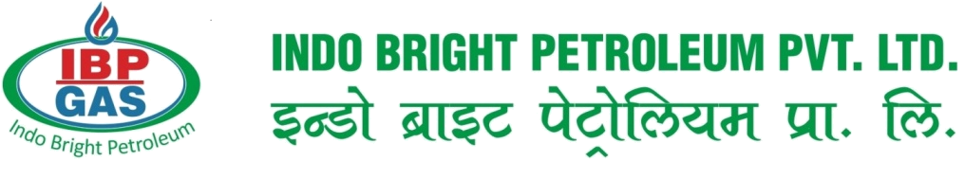
At IBP Gas we recognize that each business is unique. That's why we go beyond simply being an LPG supplier - we provide our customers with genuine account management, ensuring their individual needs are met and their expectations exceeded.
We believe it's all about the personal touch. From installation through to supply, our knowledgeable and experienced Business Managers remain dedicated to their customers. They work hard to develop long-term relationships and provide safe, innovative bulk LPG solutions to help each business succeed.
The Liberalization, Privatization and Globalization of economy have opened the path for private sectors players to enter in to those sectors which are reserved for public sector. Out of several significant sectors one of them is Petroleum sector which is opened for private sector. The Government of India has decentralized the import of LPG Indo Bright Petroleum Private Limited is a private limited company incorporated under the "laws of India".
The "Indo – Bright Petroleum Private Limited" is incorporated with the aims & objectives to cater the opportunities in the “Petroleum & Gases” sectors along with the motive to serve the nation by providing LPG to each and every household, Industry and commercial users at the competitive price with the Endeavour to obtain total customer satisfaction in the products & services thereby ensuring a long standing relationship with the customers.
We have a strong distribution & storage network, for our uninterrupted and regular supply of quality LPG. We specialize in supplies of bulk LPG, Propane and Butane from the import/export terminal of our principle. We not only supply gas but we do help our customers by our expertise and become a partner in their growth.
IBP Gas, founded in 2013, is INDIA’s leading LPG marketing company with nationwide distribution and sales operations. IBP Gas having 350+ dealers network and 4 Bottling and Blending Plants in North India. At Present 1 Head Office, 1 Corporate Office and 6 Regional Office in different places of North & East India.
The most reliable provider of affordable LPG in the country, IBP Gas product is available to households, industries and small businesses, motorists, and communities reliant on synthetic natural gas directly and through its extensive network of distributors.
ABOUT COMPANY

Slide 2
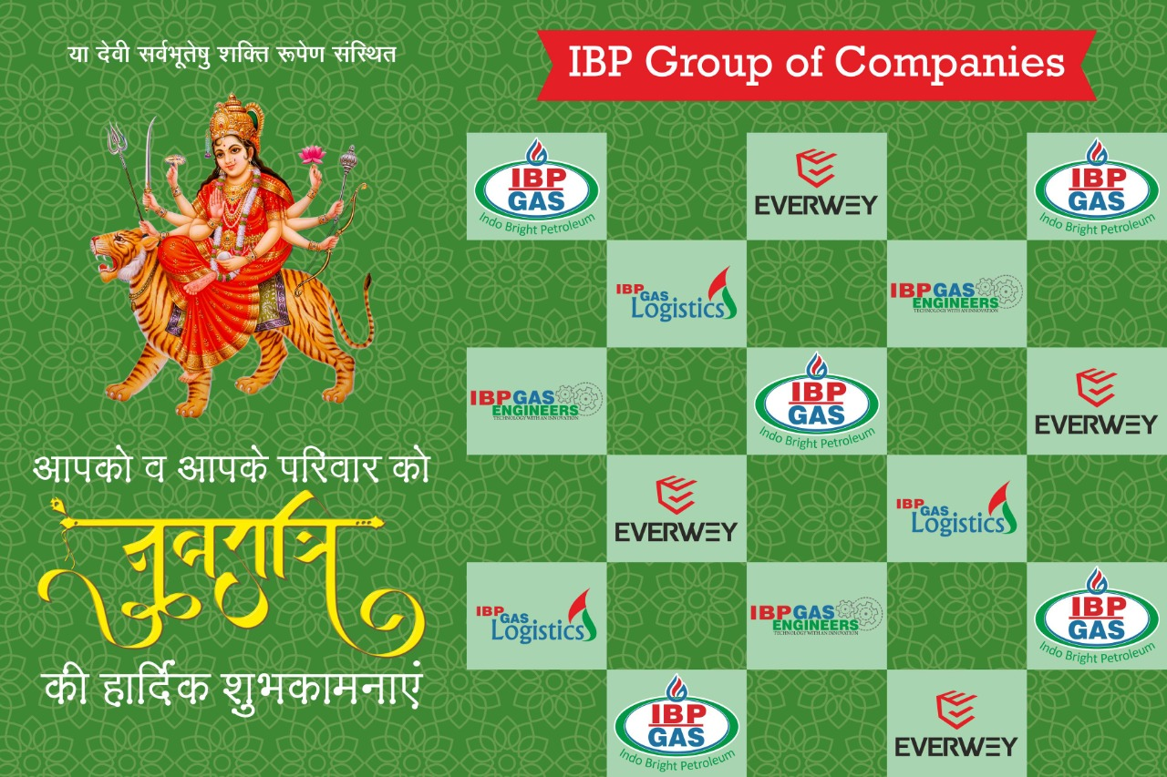

Slide 3



IBP CONGLOMERATE OF COMPANIES
INDO BRIGHT PETROLIUM PVT. LTD.
IBP GAS LOGISTICS
IBP GAS ENGINEERS
EVERWEY APPLIANCES INDIA PVT. LTD.

Slide 4
ORGANISATIONAL CHART
RAJESH KUMAR
B.TECH (M.D.)
RAKESH CHHOKER
MBA (DIR.-1)
QUALITY & DESIGN
Mr. RAHUL SAVITA
Mr. DEEPAK SHARMA
MANJEET DUHAN
MBA (DIR.-2)
FINANCE (HOD)
RAKESH CHHOKER
BUSINESS (HOD)
MANJEET DUHAN
ACCOUNT SECTION
MR. ARUN GOEL
MR. RAJESH KUMAR
SALES & MARKETING
MR. SANDEEP KUMAR
MR. ASHUTOSH

Slide 5
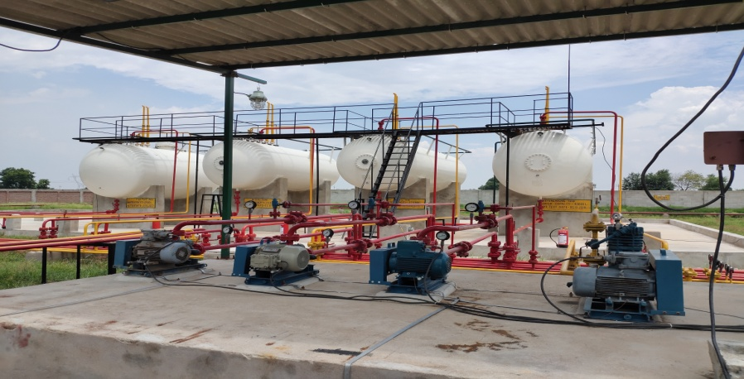
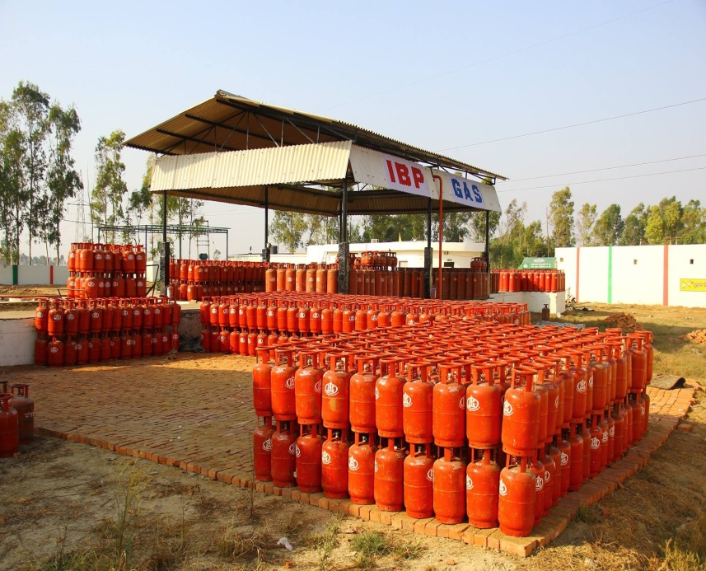
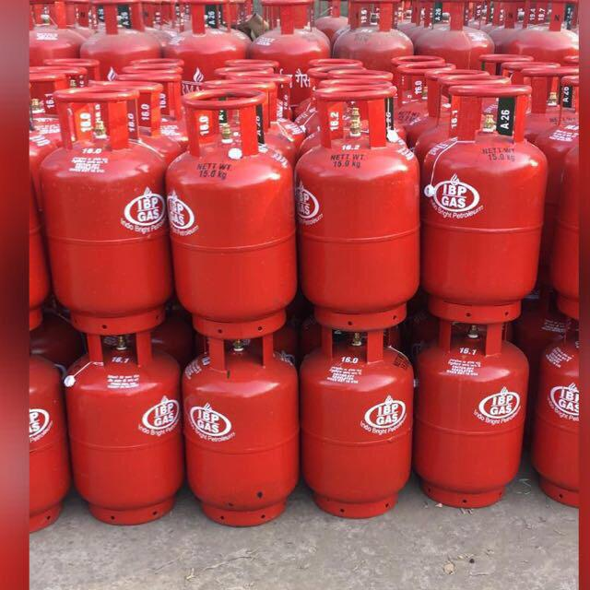
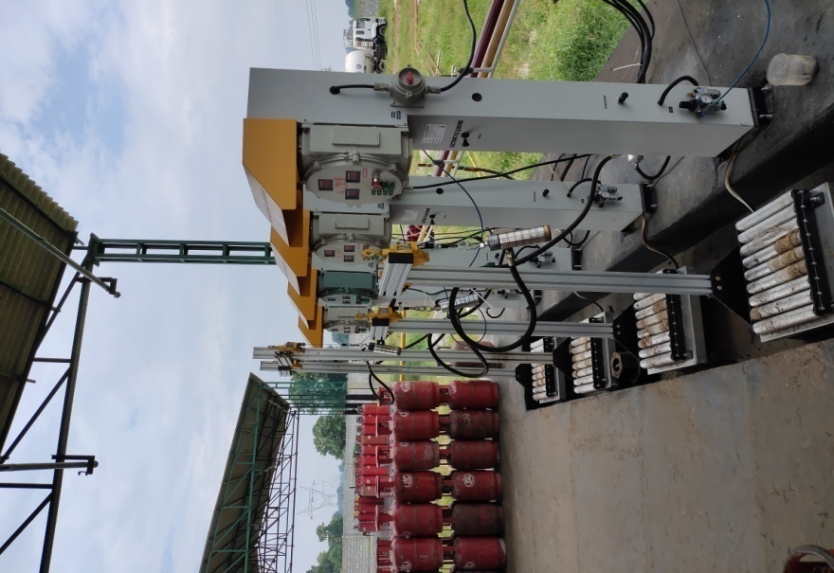
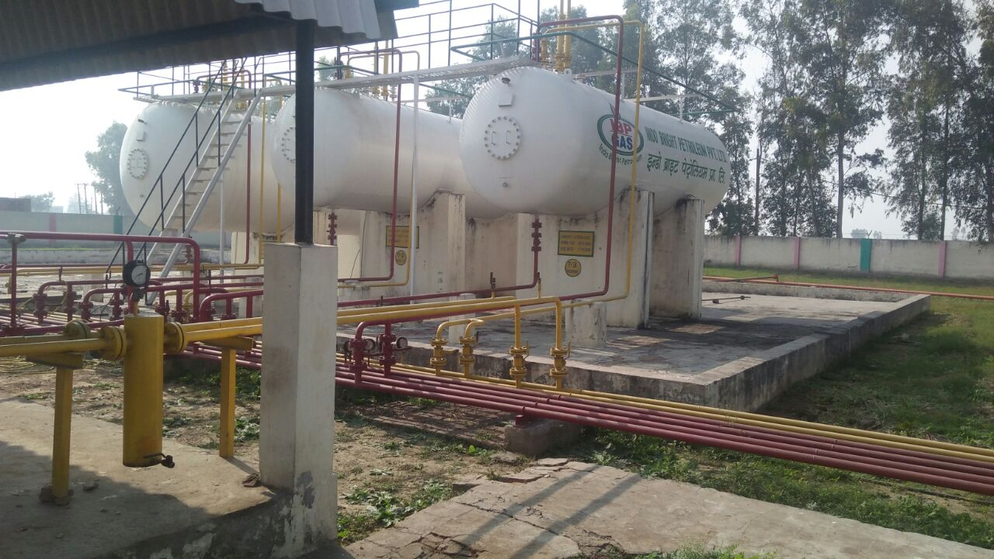
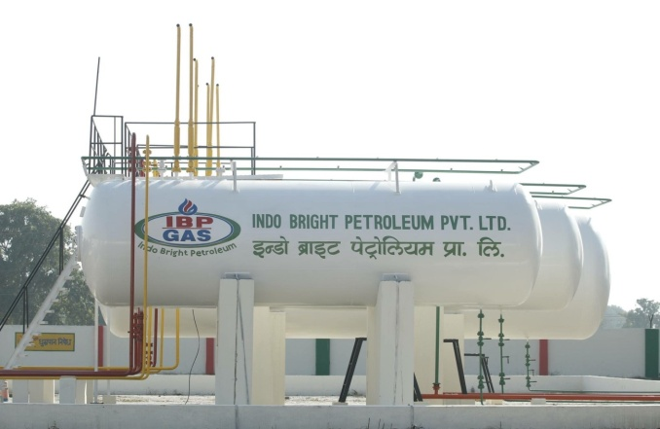
LPG PLANTS ⬇
IBP Gas, founded in 2013, is INDIA’s leading LPG marketing company with nationwide distribution and sales operations. IBP Gas having 350+ dealers network and 4 Bottling and Blending Plants in North India. At Present 1 Corporate Office and 6 Regional Office in different places of North & East India.
KARNAL ( HARYANA )
EATAWAH ( UP )
MIRZAPUR ( UP )
Raighar (Chhattisgarh )

Slide 6

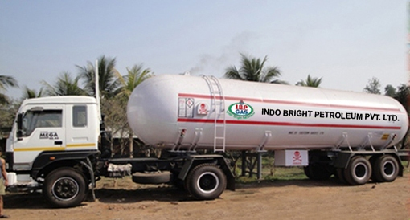
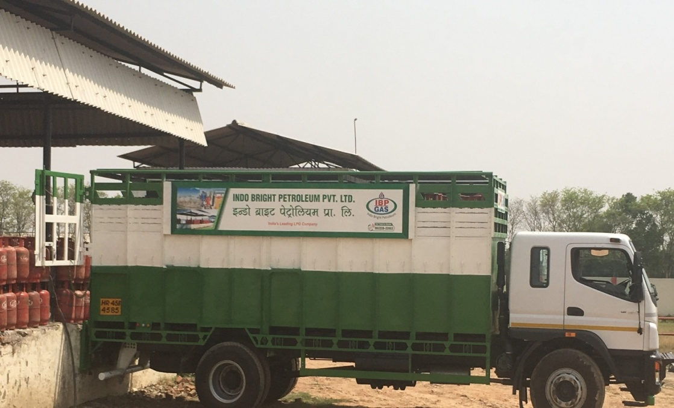
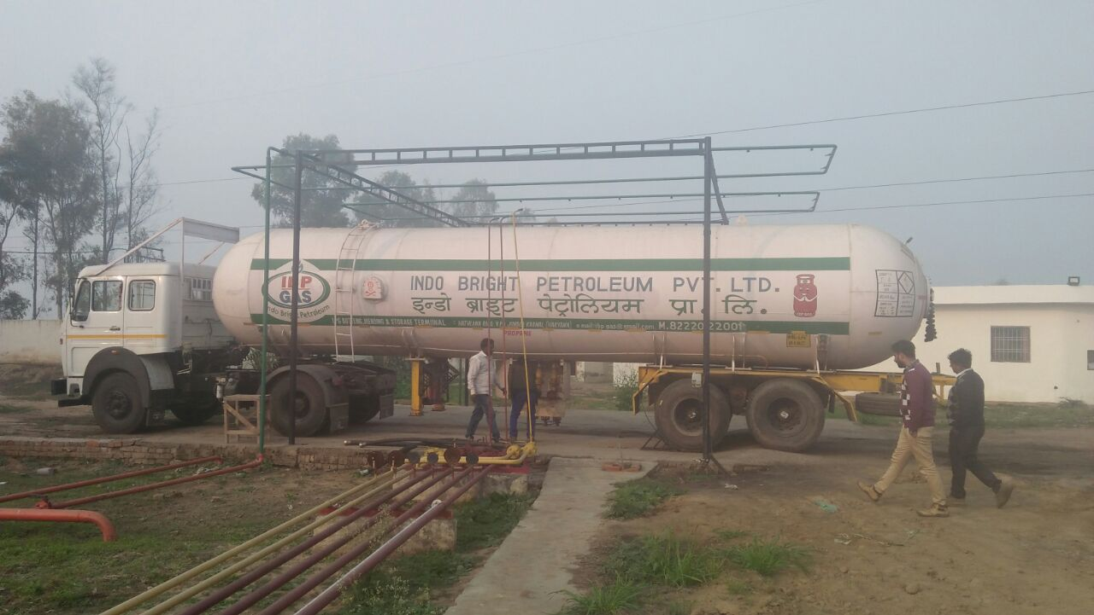
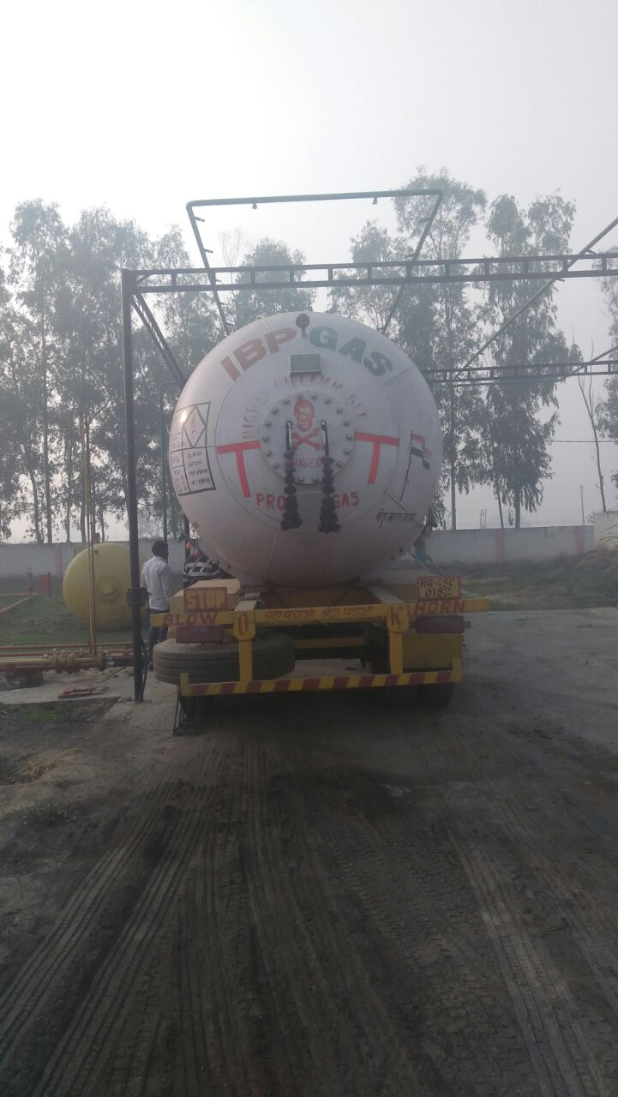

IBP GAS LOGISTICS
IBP Gas Logistic, founded in 2016 in INDIA by IBP group`s founder. Provided logistics solutions in gas supply for IBP GAS and PSU’s Government sectors.

Slide 7

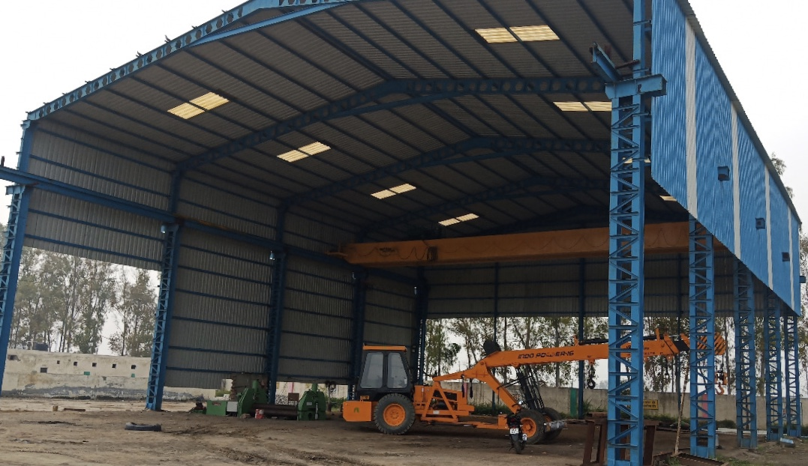
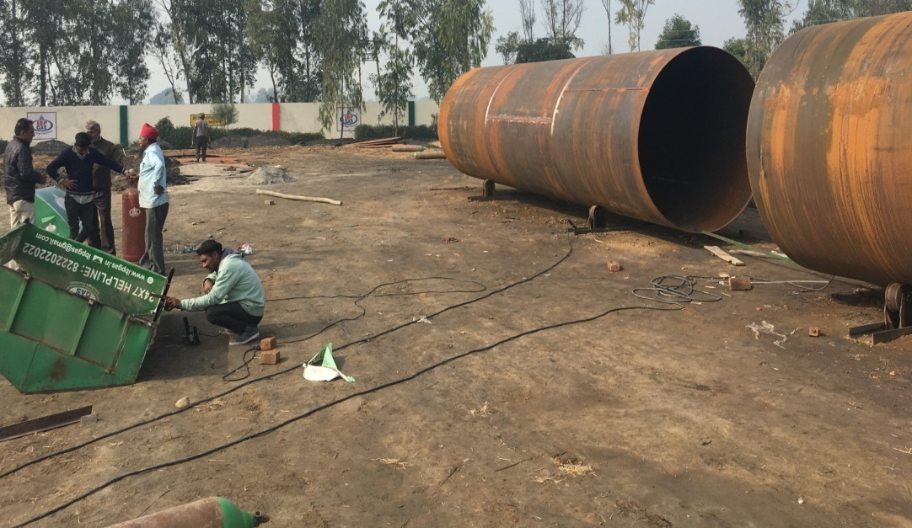
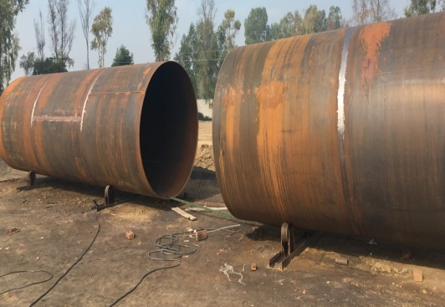
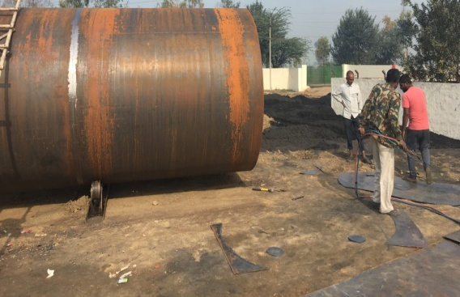

IBP Gas Engineers are Located in Karnal (Haryana) India. IBP Gas Engineers Started its business operations in the year of 2017. IBP Manufactures Presser Vessels, Petrol & Diesel Tanks. This Plant is approved by Petroleum Explosives Safety Organization (PESO) Nagpur. IBP Gas Engineers also Certified by ISO 9001:2015 for quality purpose.

Slide 8
OUR HAPPY CUSTOMERS
(1) TRINETRA PETROLEUM PVT. LTD. BHUVNESHWAR (ODISHA)
(2) GOAL GAS PVT. LTD. NAWADA (BIHAR)
(3) PETRO GAS ENERGY INDIA LTD. LUCKNOW (UTTAR PARDESH)
(4) INDO BRIGHT PETROLEUM PVT. LTD. KARNAL (HARYANA)
(5) TRINETY ENGI-TECH RAJKOT (GUJRAT)
(6) BANSIWAL INDANE UDAIPUR (RAJASTHAN)

Slide 9
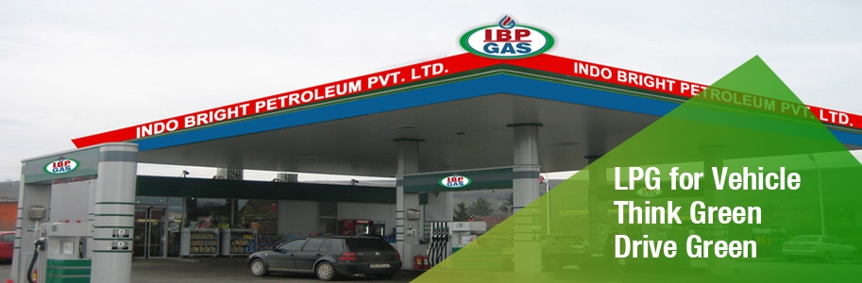

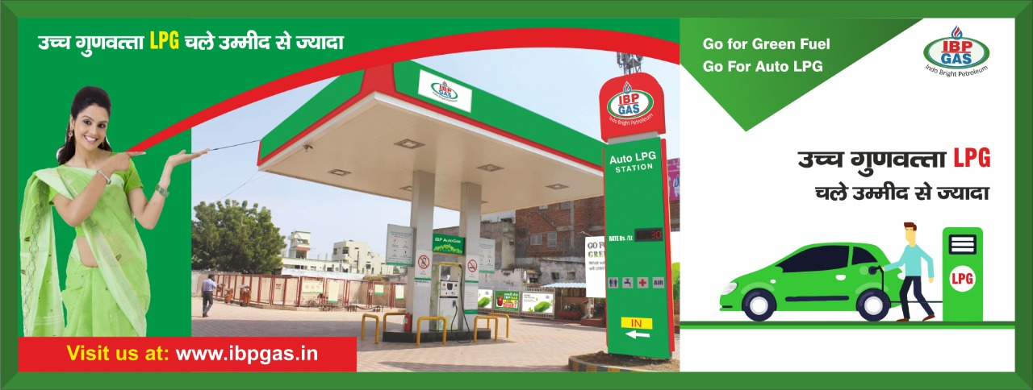
Auto LPG Dispensing Station
IBP Gas also Launched ALDS in South and East.

Slide 10
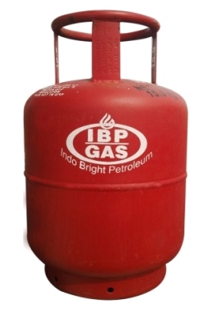



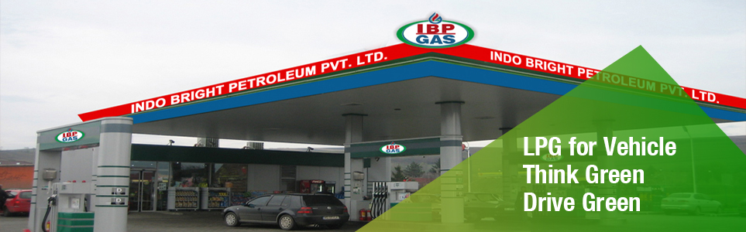
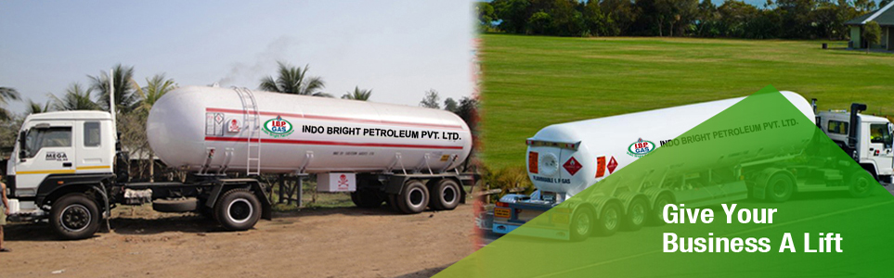
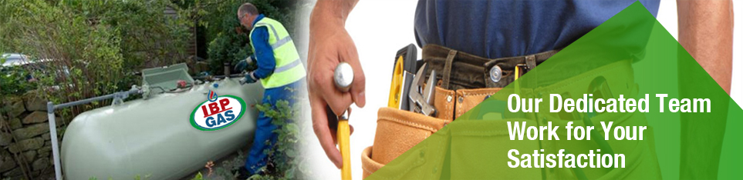
IBP PRODUCTS
2

Slide 11
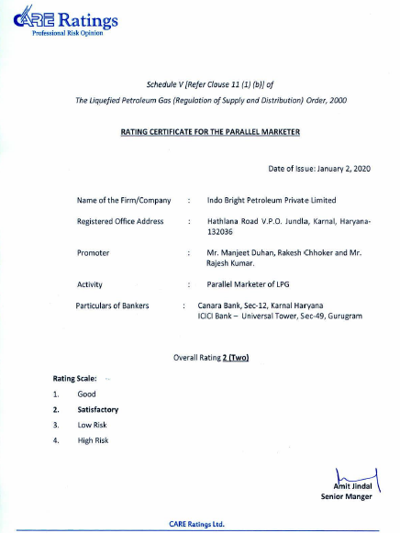
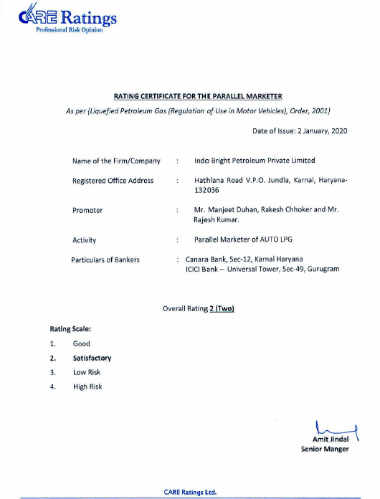
RATINGS CERTIFICATES OF LPG & AUTO LPG
2

Slide 12



founded in 2019 in INDIA by IBP group`s founder . To be provided water purification solutions to keep INDIA healthy .

Slide 13
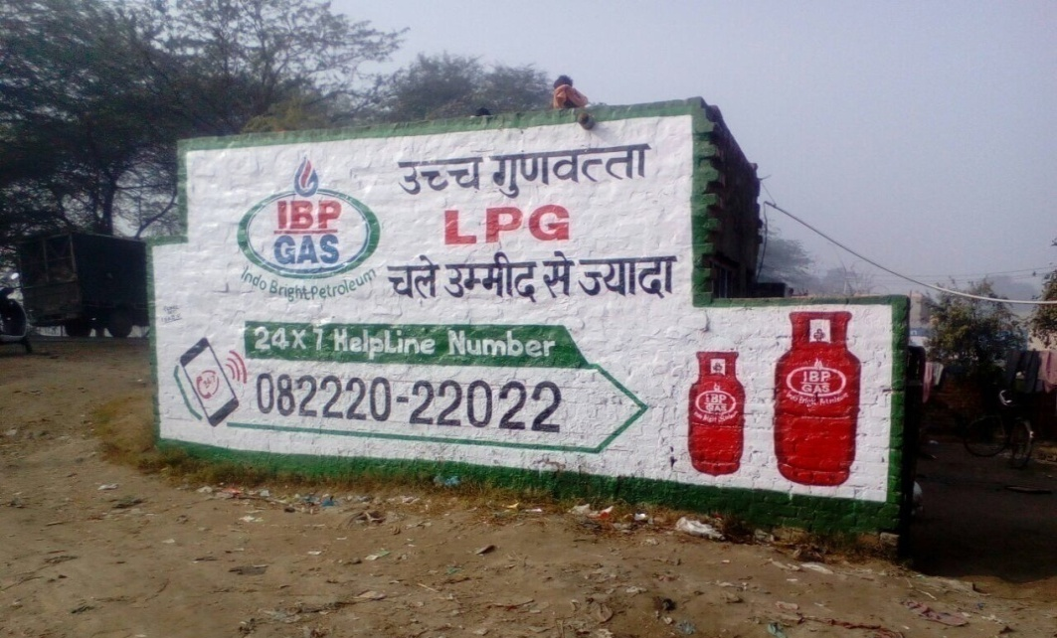
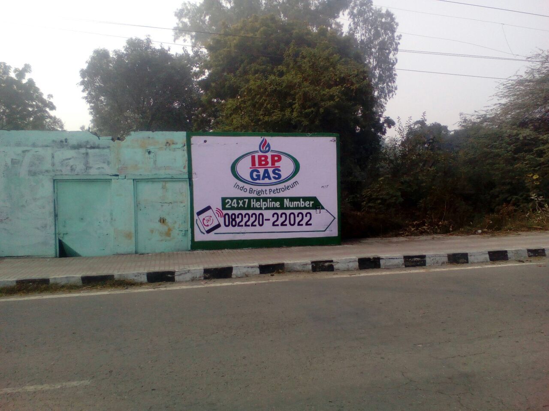
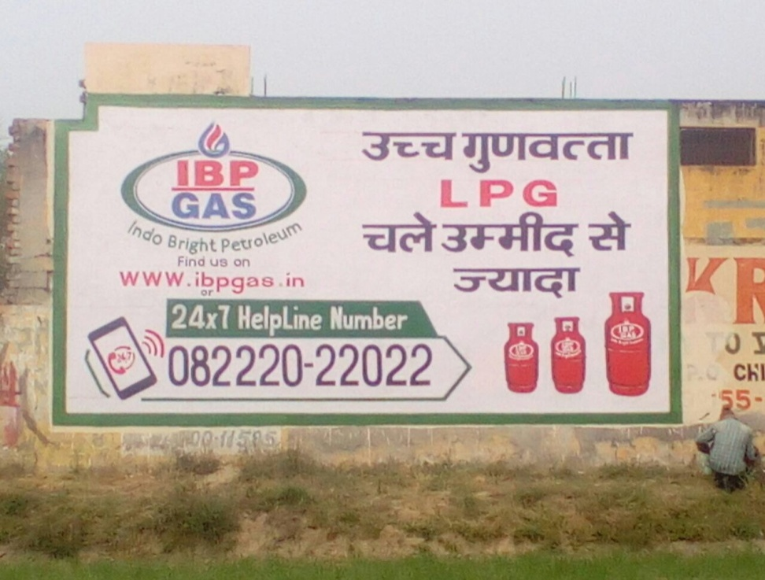
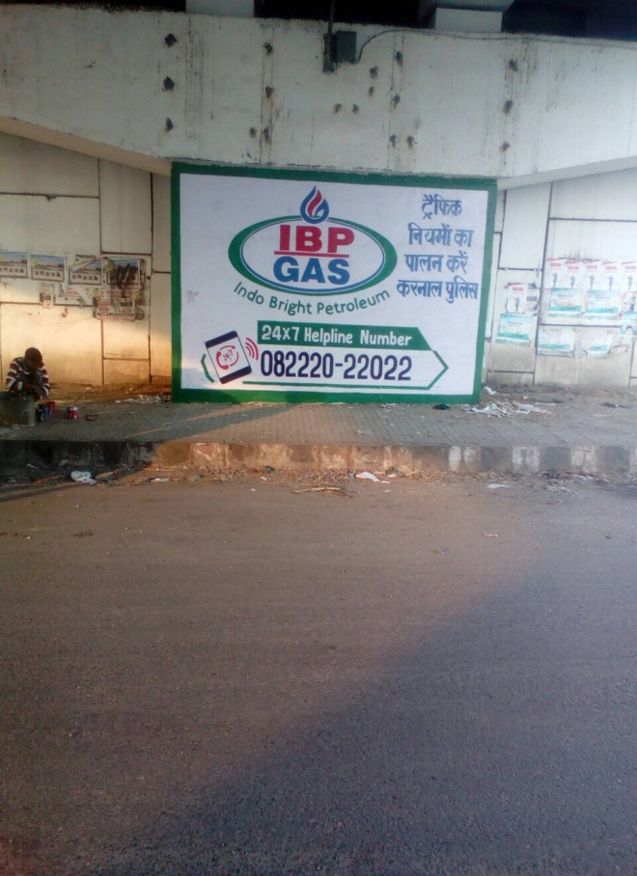
WALL PAINTING ADVERTISE

Slide 14
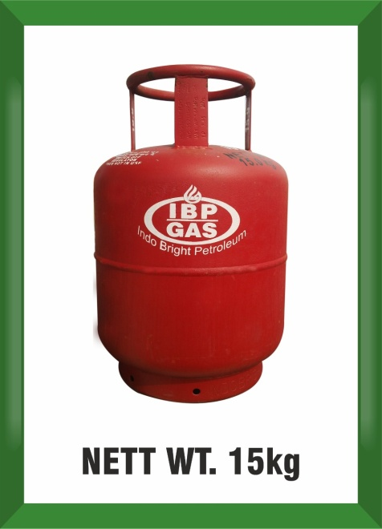
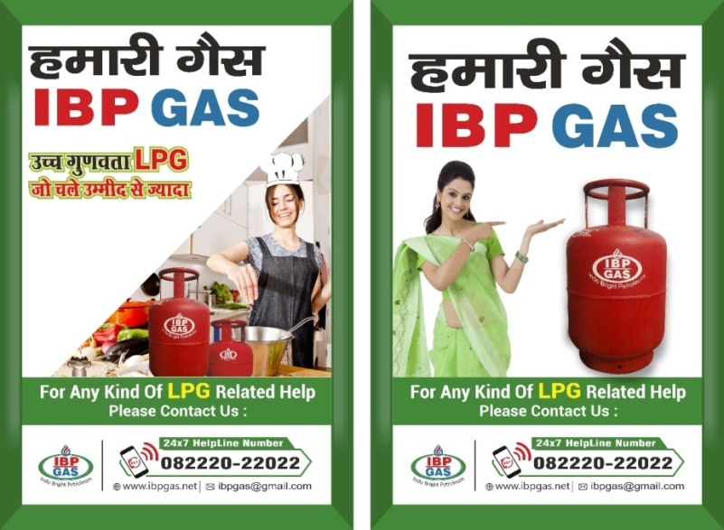

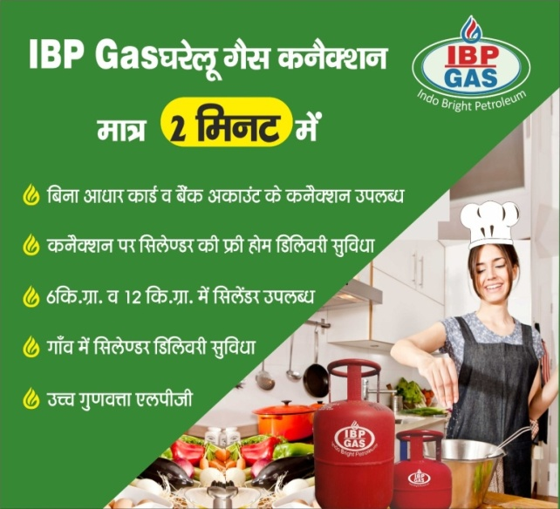
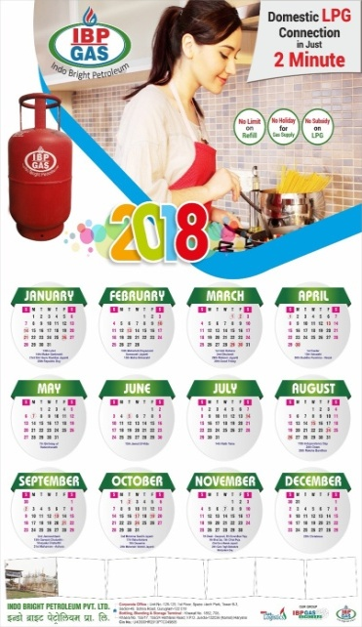
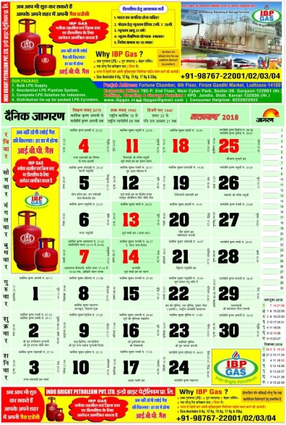
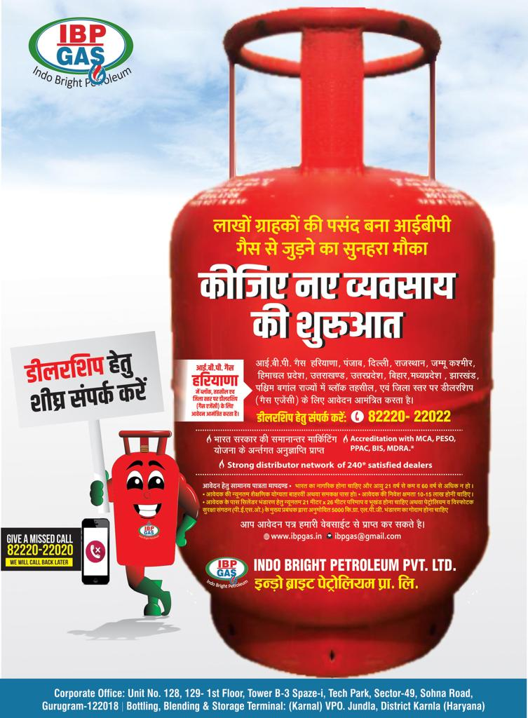
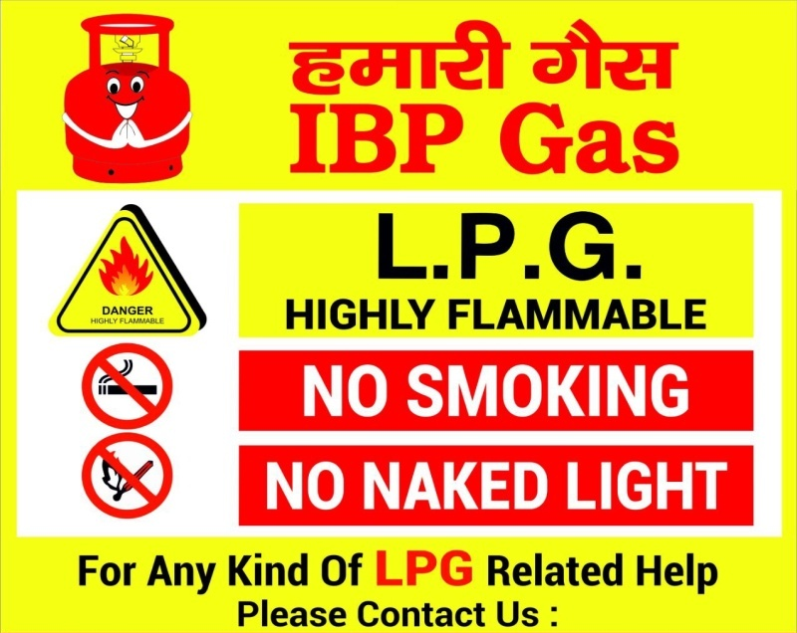
ADVERTISEMENT & SIGN BOARD DESIGN

Slide 15
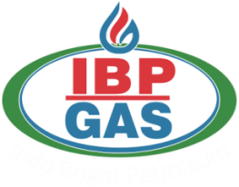



OFFICES OF IBP GROUP
Corporate Office GURUGRAM : Unit No: D-34, Ground Floor, Spaze Itech Park, Tower B1, Sector-49, Sohna Road,Gurugram-122018, Haryana.
Head Office HARYANA: Hathlana Road V.P.O. Jundla (132036), Karnal, Haryana
Branch Office UP : J B Metro Heights, 8th floor, Unit No -614, Near Transport Nagar Metro Station, Lucknow-226012
Branch Office PUNJAB : SCO 16-17,6th floor, Fortune Chamber Feroze Gandhi Market, Ludhiana, Punjab, Pin-141056
Branch Office BIHAR : Unit NO. 102, 1ST Floor, G.V. Mall, Boring Road Chauraha, Patna(Bihar)- 800001
Branch Office Chhattisgarh : C-29, Sector-1, Devendra Nagar Near City Centre Mall, Raipur, Chhattisgarh
Branch Office ODISHA : The Chandan, Ground Floor, Plot No.32E, Ashok Nagar, Bhubaneswar Khurda, Odisha-751009

Slide 16

THANK
YOU

